Slide 1

Informing the design of search systems for council members
Thomas Schoegje
Arjen de Vries, Toine Pieters
Notes:
Thomas -> work at municipality of Utrecht, where I do applied research as a phd student
I work with my professors Arjen de Vries and Toine Pieters
Specifically I work on task based search, and today I want to share our progress on developing a task-based search engine for council members

Slide 2
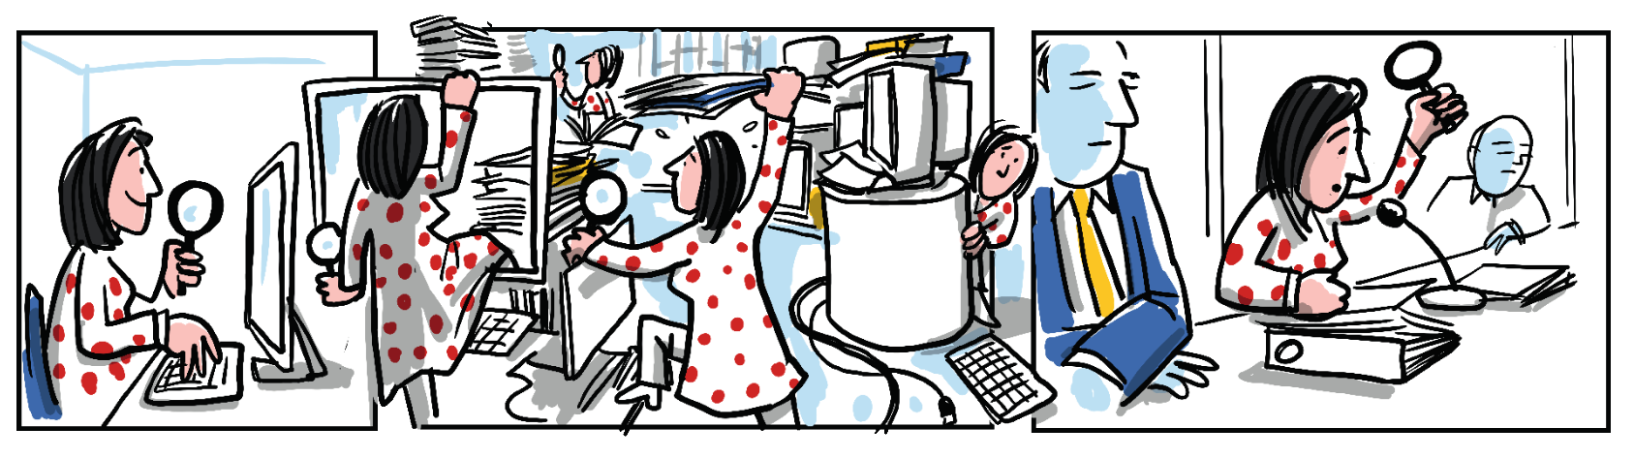
Notes:
City council members create new policies for the city. This is knowledge intensive work where they go into meetings to discuss local problems and possible solutions. To do this effectively, they need to prepare these meetings well and be informed

Slide 3
Notes:
Unfortunately, this preparation currently looks like this
Where user starts off with a quick search but it can quickly feel like they have to trudge through old archives of information
Often users don’t even know in which information sources they should search
So we want to improve this situation
So we could just get a search engine with more features and hope that’s enough, but what features do we need?
In our approach we want to look at the tasks users are performing, and what information they need to perform it. Then we can get real insight into the search requirements of our target user groups, and we could even say if they need some specialized search functionality
Our focus in this study is going to be on: how can we develop information systems based on the tasks of a user group, and then informally we show how we used this in practice to make a search engine

Slide 4
Search task
Work task
Notes:
Unfortunately, this preparation currently looks like this
Where user starts off with a quick search but it can quickly feel like they have to ‘step’ into the information and trudge through old archives of information
Often users don’t even know in which information sources they should search
So we want to improve this situation
So we could just get a search engine with more features and hope that’s enough, but what features do we need?
In our approach we want to look at the tasks users are performing, and what information they need to perform it. Then we can get real insight into the search requirements of our target user groups, and we could even say if they need some specialized search functionality
Our focus in this study is going to be on: how can we develop information systems based on the tasks of a user group, and then informally we show how we used this in practice to make a search engine
So when we look at tasks in Information seeking and retrieval literature we see two types
So there are multiple models of tasks, which are good for different purposes
For now we’re going to briefly introduce the one that’s the basis for our current work

Slide 5
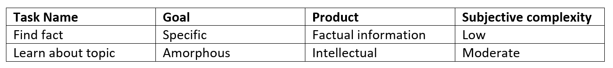
Faceted task framework
Table: Example tasks described using task facets
Source faceted model: A faceted approach to conceptualizing tasks in information seeking, Yuelin Li and Nicholas Belkin, 2008
Generic by design
Domain-independent
Does not model task topic
Notes:
The faceted task model proposed by li and Belkin is the most comprehensive way to describe tasks
A task is described by a set of orthogonal facets – for example (what will it cost ot repair the sound leak at concert hall Tivoli, or, what even is a leak’)
This is just part of the model. It is useful for many research goals – and it has been used for many goals
Our purpose is a bit different though
The model is generic by design – it doesn’t model the actions of a specific user group – but all tasks
It is domain-independent – applies everywhere
It also doesn’t model the task topic
These are strengths for some research questions, but when we want to develop a domain-specific search engine we actually don’t want this abstracted version.
We want a very specific model. Ideally we want our model to explain things like ‘well, the council member has to understand the timeline behind the political discussion of this topic‘, and then we want to link this task to a subset of information in a knowledge graph of this domain
We will try to find a way to extend the faceted model so that we can describe domain-specific tasks. To do this we will look at how the domain experts describe their own tasks: that is to say: we ask council members to describe their tasks.
We perform semi-structured interviews because this interactive format helps us get more specific about the tasks they perform
work task, dig into search tasks
We analyzed the data using a codebook analysis
This means we annotated the transcripts of those interviews based on a set of codes
We developed the set of codes in two ways – we started by taking codes from literature (specifically, we checked if we recognized the task facets from the faceted task framework)
We then checked if there were further unexplained themes in the data – a manual clustering where we say ‘these four people described something about the task in this very specific way’
After analysis we performed a very similar study at a second municipality, to see if we get the same results – so we checked if the codebook we developed was consistent and complete – also known as stable

Slide 6
Methodology
Semi-structured interviews
Codebook analysis
Known codes: faceted task framework
Emerging codes: themes in the data
Replicate interview study at second municipality
Notes:
We will try to find a way to extend the faceted model so that we can describe domain-specific tasks. To do this we will look at how the domain experts describe their own tasks
We perform semi-structured interviews because this interactive format helps us get more specific about these tasks they perform intuitively
We start by asking them about their work tasks – for what reasons do they end up in the council meetings? What triggers those reasons?
for each of those search tasks we then dug into the search tasks by asking what information they need – why they ‘step’ into the information like on the previous picture
We analyzed the data using a codebook analysis
This means we annotated the transcripts of those interviews based on a set of codes
We developed the set of codes in two ways – we started by taking codes from literature (specifically, we checked if we recognized the task facets from the faceted task framework)
We then checked if there were further unexplained themes in the data – a manual clustering where we say ‘these four people described something about the task in this very specific way’
After analysis we performed a very similar study at a second municipality, to see if we get the same results – so we checked if the codebook we developed was consistent and complete – also known as stable

Slide 7
Results
A set of facets to describe a domain-specific task model
A description of council member tasks based on those facets
Notes:
There are two types of results
We found a set of codes that we can use to describe tasks – these are our task facets to help describe domain-specific tasks
We found the specific tasks that council members perform, which we can describe using those task facets

Slide 8
Results
Task objective Informal task description
Topic aspect Types of domain knowledge
Information sources Where do users look
Retrieval unit Shape of the data
Task specificity How specific is target information
Notes:
So what facets are we using to describe tasks
Topic aspect tells us which aspect of the information is relevant
When we example ‘sound leak in the Tivoli concert hall’, there are multiple aspects we can be interested in, depending on our task
Background of the issue: what is a sound leak? What causes it?
Decision history: what has the council decided to do about it, and why?
Political context: are all political parties are happy with this solution, or did some express dissatisfaction?
Tells us which underlying datasets are important

Slide 9
Results
Example work tasks
Topic: sound leak in concert hall Tivoli
Tasks to understand background information
What is a sound leak?
How big is the problem?
Tasks to create a perspective
Should we fix it?
How do we get the funds?
Notes:
So what facets are we using to describe tasks
Topic aspect tells us which aspect of the information is relevant
When we example ‘sound leak in the Tivoli concert hall’, there are multiple aspects we can be interested in, depending on our task
Background of the issue: what is a sound leak? What causes it?
Decision history: what has the council decided to do about it, and why?
Political context: are all political parties are happy with this solution, or did some express dissatisfaction?
Tells us which underlying datasets are important

Slide 10

Results
Example search tasks
Topic: sound leak in concert hall Tivoli
Current work task
How big is the problem?
Search tasks
Google if it was in the news
Search the size of the leak in dB
Notes:
So what facets are we using to describe tasks
Topic aspect tells us which aspect of the information is relevant
When we example ‘sound leak in the Tivoli concert hall’, there are multiple aspects we can be interested in, depending on our task
Background of the issue: what is a sound leak? What causes it?
Decision history: what has the council decided to do about it, and why?
Political context: are all political parties are happy with this solution, or did some express dissatisfaction?
Tells us which underlying datasets are important

Slide 11
Results
Why support tasks
Council member can focus their efforts on preparing on the meeting, rather than hunting for information
Notes:
So what facets are we using to describe tasks
Topic aspect tells us which aspect of the information is relevant
When we example ‘sound leak in the Tivoli concert hall’, there are multiple aspects we can be interested in, depending on our task
Background of the issue: what is a sound leak? What causes it?
Decision history: what has the council decided to do about it, and why?
Political context: are all political parties are happy with this solution, or did some express dissatisfaction?
Tells us which underlying datasets are important

Slide 12
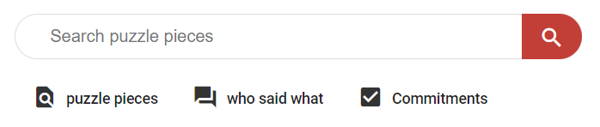
Topic aspects inform search verticals
Notes:
So here’s the search engine that is currently in production. I’m viewing it through google translate so that it’s in English, so you’ll notice some weird translations
The first thing to note is that all tasks were one of multiple topic aspects, and that each topic aspect was associated with a different type of information. That is why we introduced multiple search verticals. We can look at documents, political statements (which we extracted from certain document types), and political commitments (which we extracted from different documents)

Slide 13
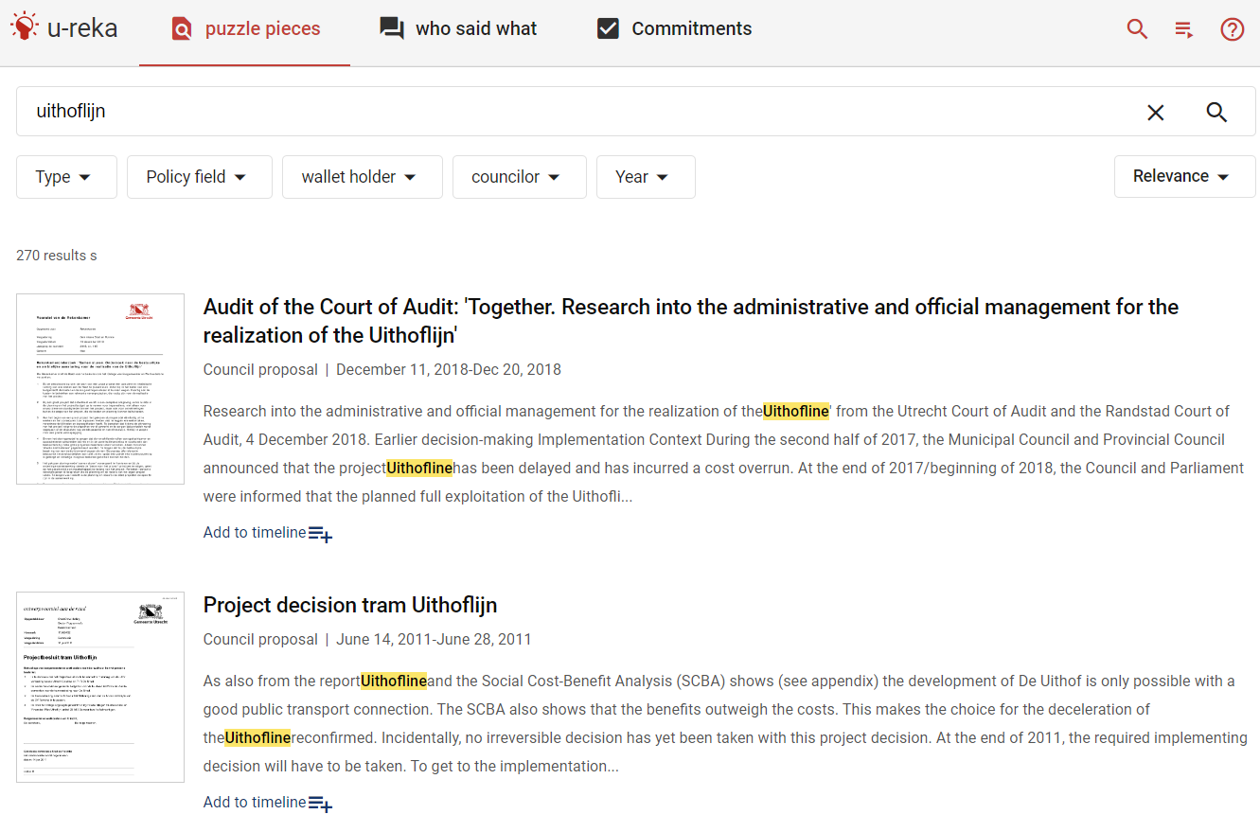
Result presentation is based on retrieval unit facet
Notes:
So each search vertical has a different retrieval unit – based on the retrieval units necessary for the work tasks – such as the dates
We also see a number of filters and search options here. These were informed by the search task descriptions

Slide 14
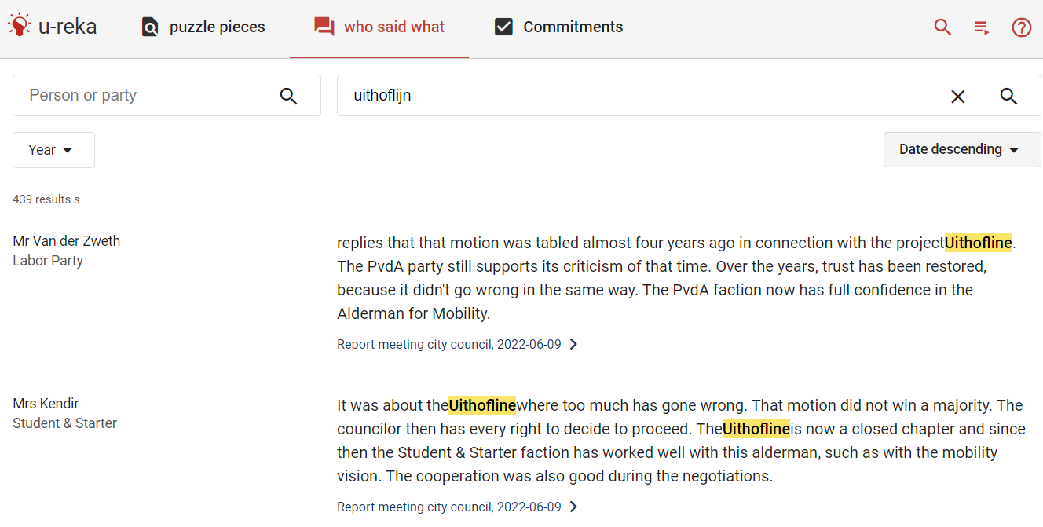
Filters informed by requirements of specific tasks
Notes:
The same goes for the political statements vertical

Slide 15
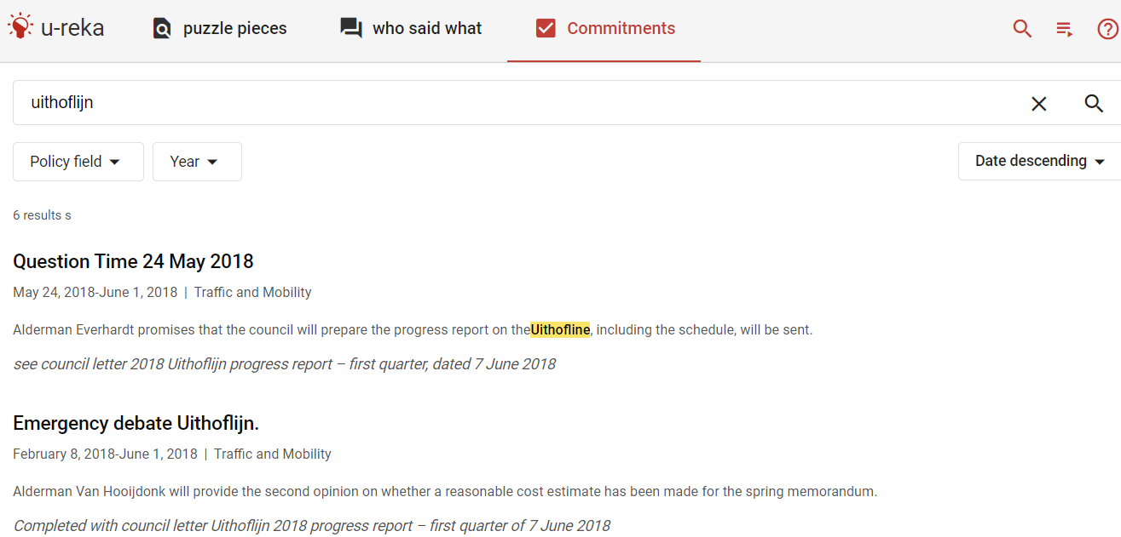
Extracted from meeting minutes, which served as information sources
Notes:
And the political commitments vertical

Slide 16
click
Notes:
So the last thing I want to show is what happens when you click a document search result

Slide 17
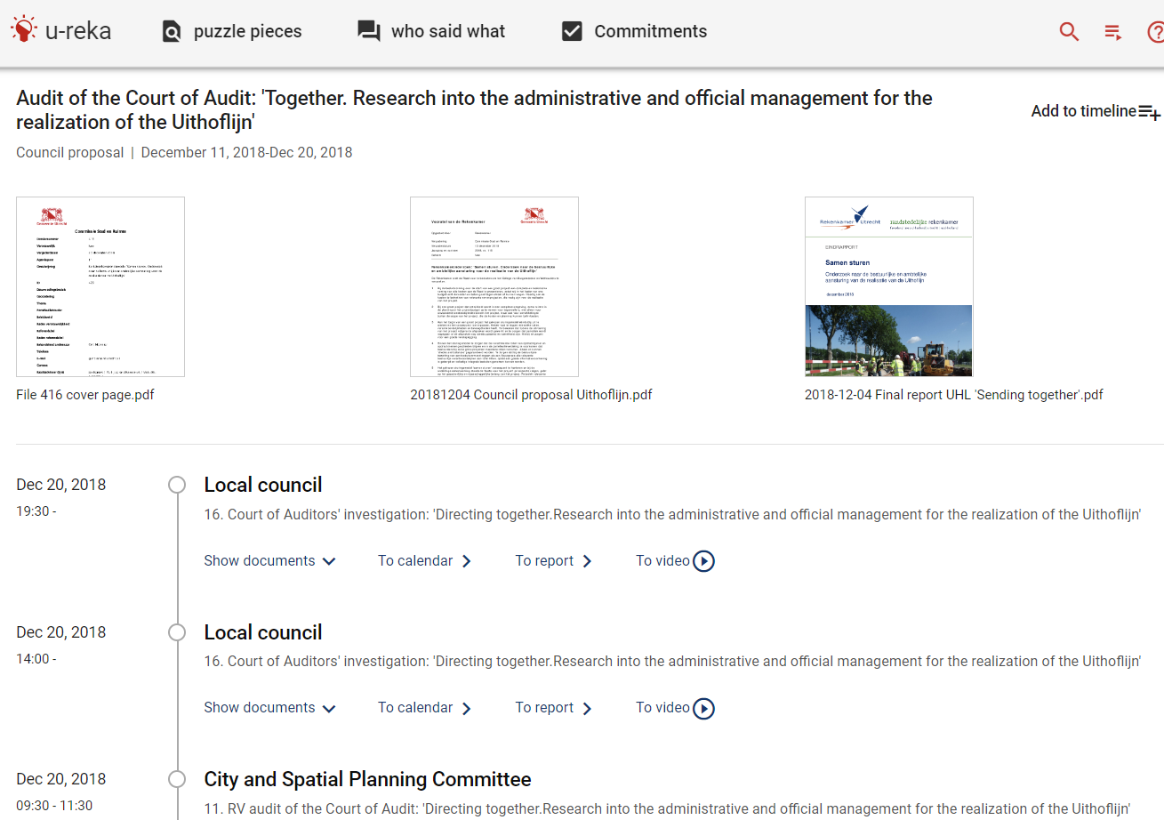
The decision history tasks told us to structure the data
Notes:
We get a search result page where we put the political document in the context of the political decision making history
So where previously the users had to piece together fragments of information into a story of what happened, we now try to deliver a useful story

Slide 18
Discussion
Council members currently choose to use it over the previous system, which is still available
Launched with a public `search race ’ where novices using the new system outperformed experts using the old system

Slide 19

Conclusion
Enabled the municipality to innovate around the user’s needs rather than the technology available
We can adapt and re-use the search system because users at different municipalities have the same tasks
Demo: ureka.utrecht.nl
Contact: t.schoegje@utrecht.nl
Notes:
There are many approaches we can take to designing information systems, and it can be hard to choose one
We found that a task-based approach to design helps us invest into features that provide value to our users
We also found that the council members at multiple municipalities have the same search tasks. So even if there are different datasets underlying those systems, it seems plausible that we could work together towards better common search tools. That’s kind of encouraging to me, because I think shared goals and resources can get more fundamental solutions than separated initiatives
TODO bring it back together

